Slide 1
Bright TV Engaging Audiences with Sports, Music, and Entertainment
Project Context
Bright TV delivers engaging sports, music, and entertainment content to a diverse audience. This project analyses viewership trends is to identify top-performing shows, optimize programming, and boost audience engagement. The goal is to make Bright TV the go-to channel for all age groups and focus on events while keeping content fun and inclusive.
B
Sports
T
Music
Shows
V
Presented by Kyle Ndlovu

Slide 2

Viewership Insights
Top channels
Sports, Shows and music entertainment
Main viewers: Youth & adults
1
Viewing Drivers
Content: Sports & family shows drive engagement
Timing: Weekends & evenings are busiest; weekdays slower
1
2
2
3
4
Growth Opportunities
-Segmented offers: kids/family packs for parents, sports packs for males
-Digital/mobile: promote streaming for youth and urban viewers
-Rewards & partnerships
3

Slide 3
Age Demographics
31.48%
55.98%
Adults
Youth
Target audience
7.36%
Teens
1.03%
Kids
0.49 %
Senoir

Slide 4
Age & Gender Insight
Target audience: Primarily male youth & adults.
Content alignment: Focus programming and
promotions on genres that resonate strongly
with young men and adult males (e.g., sports
B
Female focused content: Introduce genres
with strong female appeal (drama, lifestyle,
music, talk shows).
T
Balanced programming : Add shows parents
are likely to co-view with kids (cartoons, family
movies, edutainment) to attract households.
V

Slide 5
• Prioritize content for the Black audience, as they represent the largest segment
• Tailor content by province:
Western Cape: Focus on the Colored audience.
Limpopo: Focus on the Indian/Asian audience.
Gauteng & Free State: Include the White audience.
• Ensure content remains inclusive and resonates across all demographic groups.

Slide 6
Viewership by Time
Mornings-Highest priority, with peak viewership midweek and on Saturdays.
Weekends-Strongest engagement—ideal for major shows and advertising campaigns..
Friday & Saturday afternoons + nights-Prime entertainment slots for music, movies, and sports.
Evenings-Currently underperforming—opportunity to experiment with new shows to boost audience.
Morning
00:00:00-11:59:59
Afternoon
12:00:00-14:59:59
Late Afternoon
15:00:00-17:59:59
Evening
18:00:00- 19:59:59
Night
20:00:00- 23:59:59

Slide 7
Most Popular Channels by Audience
Sports: Continue prioritizing sports since they dominate adult and youth viewership
55%
Music & Entertainment: Target programming toward youth audiences, who engage most here.
35%
Winning category: Double down on sports, action, comedy, and reality, which are already performing well.
New Development: Expand kids and family programming to capture household viewership and diversify engagement.

Slide 8
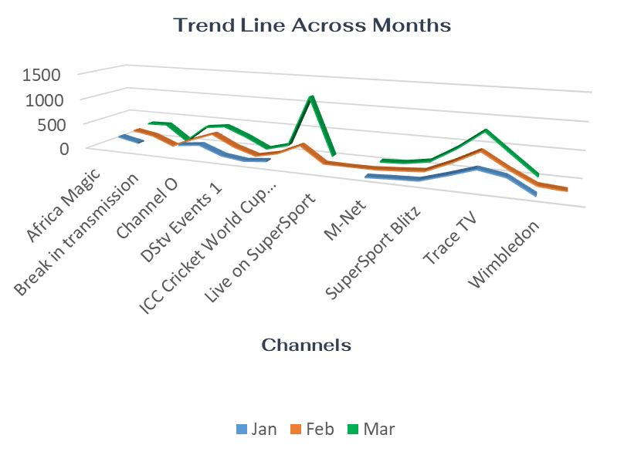

Trend Line Across Months
Super sport Live Events consistently performs well every month → strong core audience for sports.
Audience Retention:Identify off-peak months/channels and introduce targeted shows to smooth viewership outside major events
Channel O and Trace TV are steady performers in music/entertainment.
ICC Cricket World Cup 2011 in Feb–Mar caused spikes → major event-driven engagement
Content Pairing:Pair live sports with complementary entertainment content (e.g., music recaps, celebrity interviews) during high-viewership windows.

